Slide 1
Box Office Forecast
(Team Blockbuster)
Jin Liu
Prakshita Nag
Rakesh Reddy

Slide 2
Project Description
Dataset: Movie data between 1997 and 2017
How do movies fare in terms of genre?
Does rating of a movie have any effect on box office?
As a movie production house, which Actors/Directors would they consider cast in a movie?
Can we build a Machine Learning Model that can predict the profitability of a movie?

Slide 3
Data Description
Variable | Description
movie_id | Unique ID used refer to the movie.
title | Title of the movie
plot | Movie plot summary
rating | MPAA appropriate audience rating
movie_rating | voters’ scoring of a movie on a scale from 1-10 (10 being best)
metacritic | Metacritic movie score on a scale of 0-100 (100 being best).
dvd_release | Movie release date on DVD
production | Principal production company
actors | Lead actors
movie_votes | Total votes given to movie
poster | Movie poster artwork
director | Movie director
release_date | Theatrical release date
runtime | Runtime length of movie in minutes
genre | Genre classification
awards | Academy awards & nominations
keywords | Keywords associated with the movie
Budget | Budget spent on the movie production, marketing, and distribution.
box office gross | Box office gross returns as of 9/21/2017

Slide 4

Data entry example
Variable | Description
movie_id | tt0499549
title | Avatar
plot | A paraplegic marine dispatched to the moon Pandora on a unique mission becomes torn between following his orders and protecting the world he feels is his home.
rating | PG-13
movie_rating | 7.8
metacritic | 83
dvd_release | 22-Apr-10
production | 20th Century Fox
actors | Sam Worthington, Zoe Saldana, Sigourney Weaver, Stephen Lang
movie_votes | 949,141
poster | https://images-na.ssl-images-amazon.com/images/M/MV5BMTYwOTEwNjAzMl5BMl5BanBnXkFtZTcwODc5MTUwMw@@._V1_SX300.jpg
director | James Cameron
release_date | 18-Dec-09
runtime | 162 min
genre | Action, Adventure, Fantasy
awards | Won 3 Oscars. Another 85 wins & 128 nominations.
keywords | paraplegic|avatar|marine|native|future|ecology|forest-protection|spiritualism|battle|…
Budget | 237000000
box office gross | 760507625

Slide 5
Data Preprocessing on selected features
Rating, Genre: get dummies (binary)
Movie rates, Movie_votes: as is
Production, Actors, Director: “Star Power” -- Sum of historical box office number (Float)
Release_dates: Extract the months. (Category)
Runtime: Extract the minutes. (Integer)
Budget: Standardize based on inflation rates. (Float)
Box Office Gross: Standardize based on inflation rates. (Float)
N/A values: look into IMDb and fill up. If not found, remove the movie from the data.

Slide 6
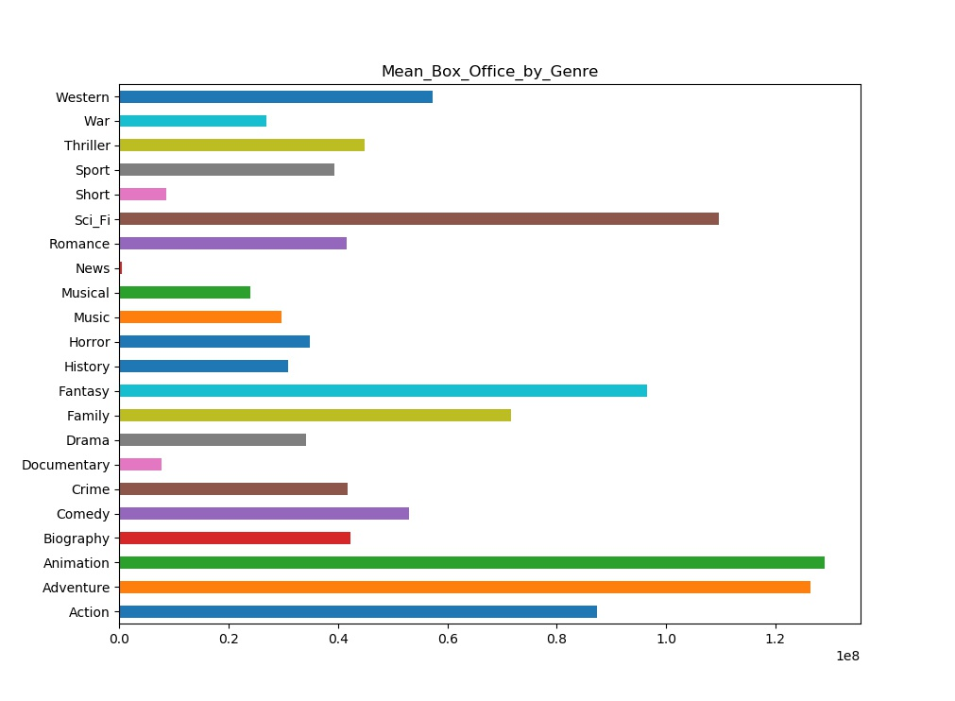

Slide 7
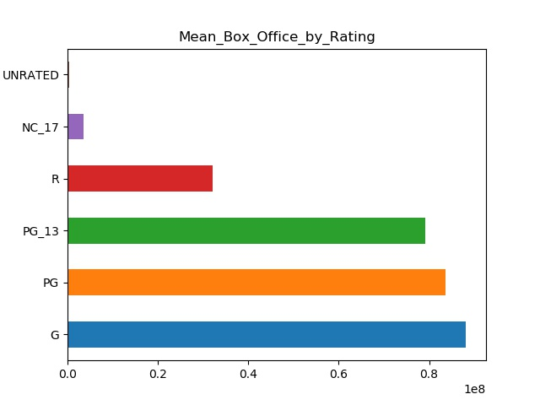

Slide 8
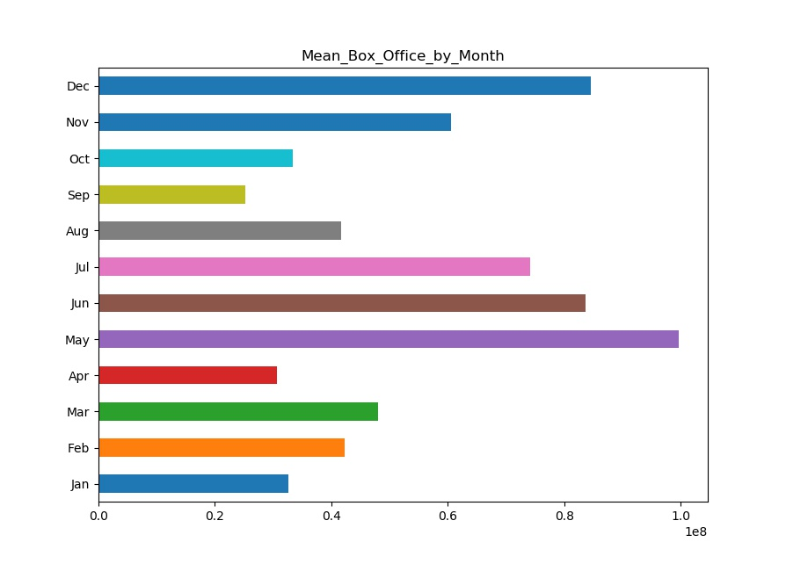

Slide 9
Movie Seasons
Blockbuster season: May, June, July
Oscar Bait Season: November, December
Dump Season: other months
Convert the Months to Seasons

Slide 10
Classify profitability based upon
Box Office/Budget ratio
Poor(1): ratio < 1 These movies definitely lose money from box office.
Fair(2): ratio between 1 and 2. These movies can earn budget back from box office,but are barely profitable.
Good(3): ratio between 2 and 4. These movies are guaranteed profitable.
Great(4): ratio above 4. These movies are the true blockbusters that earned more than expected.

Slide 11
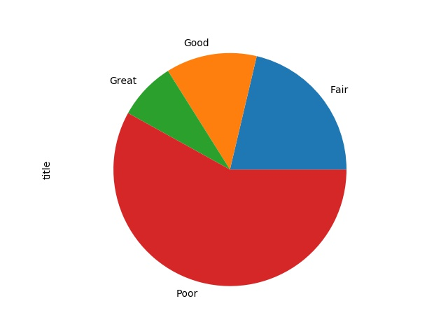

Slide 12
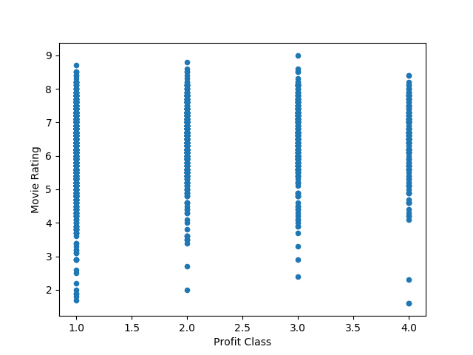

Slide 13
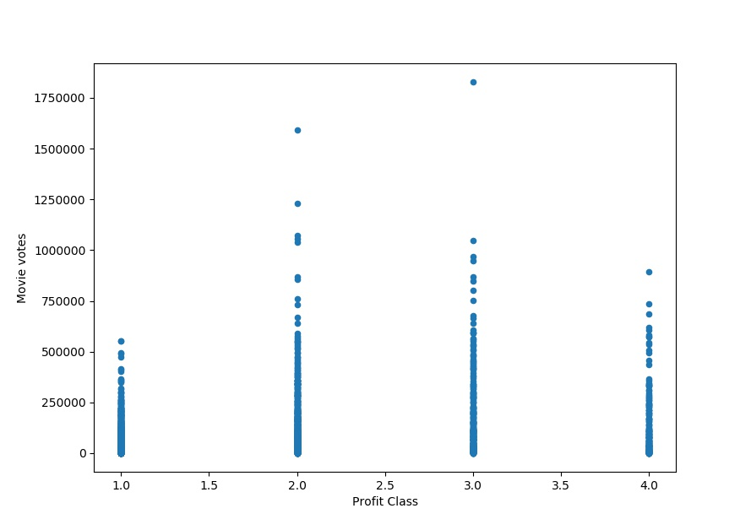

Slide 14
Modeling
Training Data: movies from 1997 to 2015
Testing Data: movies between 2016 and 2017

Slide 15
Regression Models
 | XGBOOST | SVM | RANDOM FOREST | MULTI LINEAR PERCEPTRON REGRESSOR
R SQUARE | -0.33 | -0.12 | 0.15 | -0.014
MSE | 1.06e16 | 8.9e16 | 6.7e15 | 9.8e15

Slide 16
Classification Models
 | KNN | Neural Net | Xgboost | SVM
TP | 154 | 120 | 164 | 189
TN | 32 | 59 | 36 | 0
FP | 96 | 69 | 92 | 128
FN | 32 | 69 | 25 | 0
Accuracy | 58.7% | 56.5% | 63.1% | 59.6%

Slide 17
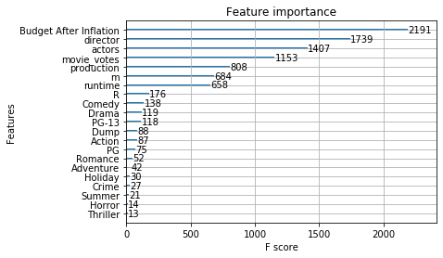

Slide 18
Conclusion
Based upon our data, classification models predict the profitability better than the regression models
All regression models are barely usable, while random forest provides a slightly better model.
Among classification models, Xgboost gives best accuracy, while svm provided the worst confusion matrix.
In general, without the plot and keywords inputs, it might be not practical to predict the box office based upon limited attributes of a movie.

Slide 19
What we have learned
Clean data appropriately
Implement machine learning models in Python
Tuning parameters for eight different models
Build indications from the results of data analysis
Practice project presentation
In-depth understanding on data analysis process

